Slide 1
Natural Language Understanding
Have you ever asked: “Alexa, what’s the weather like outside?” or “Siri, how is the traffic this morning?”
If so, you would have received a data-supported answer from your personal digital assistant.
Just how can it understand that you are interested in knowing the weather in a specific location or the traffic on the exact route that you travel every morning?
The answer is NLU: Natural language understanding. This artificial intelligence centered automation enables voice technology, like Siri, Cortana, Alexa and Google’s Assistant, to deduce what you actually mean, regardless of the way you express it.

Slide 2
Natural Language Understanding: Definition
Natural Language Understanding (NLU) is defined by Gartner as “the comprehension by computers of the structure and meaning of human language (e.g., English, Spanish, Japanese), allowing users to interact with the computer using natural sentences”. In other words, NLU is Artificial Intelligence that uses computer software to interpret text and any type of unstructured data.
NLU can digest a text, translate it into computer language and produce an output in a language that humans can understand.

Slide 3

Natural Language Processing
Natural Language Processing

Slide 4
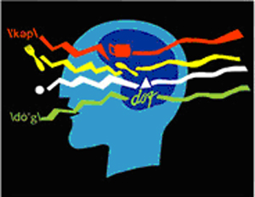
Components of Natural Language Processing
Introduction

Slide 5
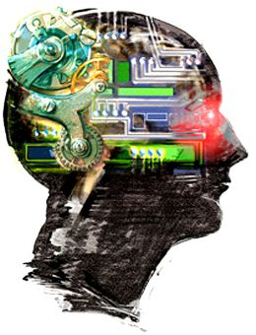
Natural?
Natural Language?
  Refers to the language spoken by people, e.g. Hindi, English, etc as opposed to artificial languages, like C++, Java, etc.
Natural Language Processing
  Applications that deal with natural language in a way or another
Computational Linguistics
  Doing linguistics on computers.
  Is an interdisciplinary field dealing with the statistical and/or rule-based modeling of natural language from a computational perspective

Slide 6
Computers Lack Knowledge!
People have no trouble understanding language
  Common sense knowledge
  Reasoning capacity
  Experience
Computers have
  No common sense knowledge
  No reasoning capacity

Slide 7
Where does NLP fit in the CS taxonomy?
Computers
Databases
Algorithms
Networking
Artificial Intelligence
Robotics
Natural Language Processing
Search
Information
Retrieval
Machine
Translation
Language
Analysis
Semantics
Parsing

Slide 8
What is
Natural Language Processing?
Natural Language Generation?
Natural Language Understanding?

Slide 9
Terminology
Natural language processing (NLP) is a field of computer science and linguistics concerned with the interactions between computers and human (natural) languages.
Natural language generation systems convert information from computer databases into readable human language.
Natural language understanding systems convert samples of human language into more formal representations such as parse trees or first-order logic structures that are easier for computer programs to manipulate. Many problems within NLP apply to both generation and understanding;
For example:-
a computer must be able to model morphology (the structure of words) in order to understand an English sentence, and a model of morphology is also needed for producing a grammatically correct English sentence.

Slide 10
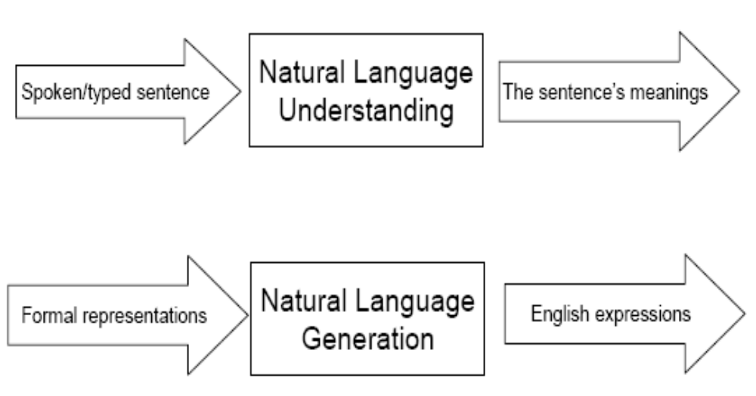
Input-Process-Output in NLP

Slide 11
Levels of Language
  Phonological: A phoneme is the smallest unit of sound and it relates sounds to the words that humans recognize.
  Morphological: A morpheme is the smallest unit of meaning and it relates to word constructions from basic units called morphemes.
  Lexical: Interpretation of the meaning of individual words.
  Syntactic: It relates to how words are put together or structured to form grammatically correct sentences in the language.
  Semantic: It is concerned with the meanings of words and phrases and how they combine to form sentences in the language.
  Pragmatic: It relates to the use of sentences in different contexts and how the context affects the meaning of the sentences.

Slide 12
Natural Language Understanding: Architecture
Raw speech signal
    Speech recognition
Sequence of words spoken
    Syntactic analysis using knowledge of the grammar
Structure of the sentence
    Semantic analysis using info about meanings of words
Partial representation of meaning of sentence
    Pragmatic analysis using info. about context
Final representation of meaning of sentence
OUTPUT

Slide 13
NLU & NLP: What is the difference?
NLU and natural language processing (NLP) are often confused. Instead they are different parts of the same process of natural language elaboration. Indeed, NLU is a component of NLP. More precisely, it is a subset of the understanding and comprehension part of natural language processing.
Natural language understanding interprets the meaning that the user communicates and classifies it into proper intents. For example, it is relatively easy for humans who speak the same language to understand each other, although mispronunciations, choice of vocabulary or phrasings may complicate this. NLU is responsible for this task of distinguishing what is meant by applying a range of processes such as text categorization, content analysis and sentiment analysis, which enables the machine to handle different inputs.

Slide 14
NLU & NLP: What is the difference?
On the other hand, natural language processing is an umbrella term to explain the whole process of turning unstructured data into structured data. NLP helps technology to engage in communication using natural human language. As a result, we now have the opportunity to establish a conversation with virtual technology in order to accomplish tasks and answer questions.

